Slide 1
Differences In APOE Expression Between Alzheimer’s Disease Patients and Non-Cognitively Impaired Patients
Andrew Yu

Slide 2
Why study APOE?
APOE transports fats around the bloodstream by forming lipoproteins (Corbo 2003)
APOE has been shown to increase the chances of developing Alzheimer’s disease (Bryant 2021)

Slide 3
Data Introduction
Rush Alzheimer’s Disease Center
ENCODE
Total RNA-Seq Data
Gene Quantification Data
FPKM
Alzheimer’s Disease Patients = 35 Samples
Control Patients = 36 Samples

Slide 4
Diagnosis of the Patients
Patients are Volunteers (Bennet 2012)
All patients are evaluated for dementia post-mortem
In the paper posted by Rush University
Patients Diagnosed with AD already had Alzheimer’s disease years prior to their contribution to the study

Slide 5
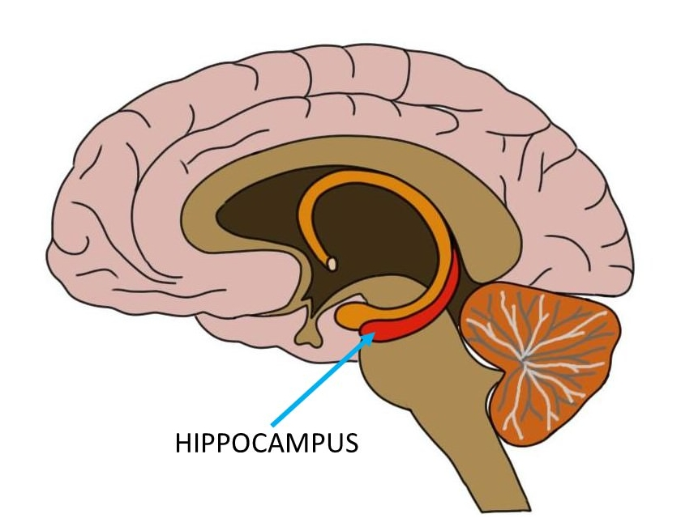
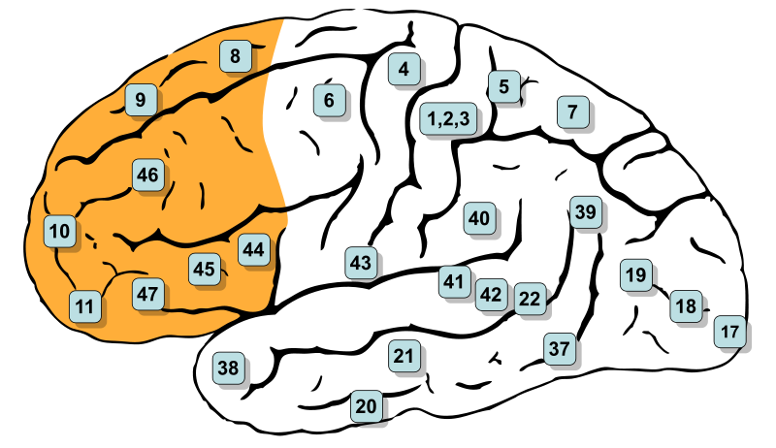
Samples

Slide 6
Analysis of the APOE Comparison Data
A T-Test is performed to see if the difference seen on the graph is significant
Variance for APOE Gene Expression
Independent (Patients or Control)
Normally Distributed (Same Distribution of Data)

Slide 7
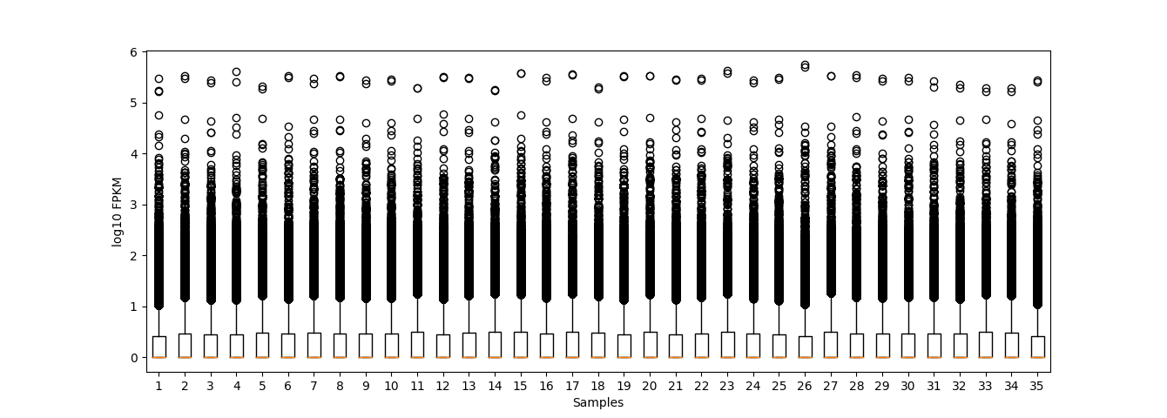
Comparative Eligibility
Figure 1. Distribution of Genes for Alzheimer’s Disease Patients

Slide 8
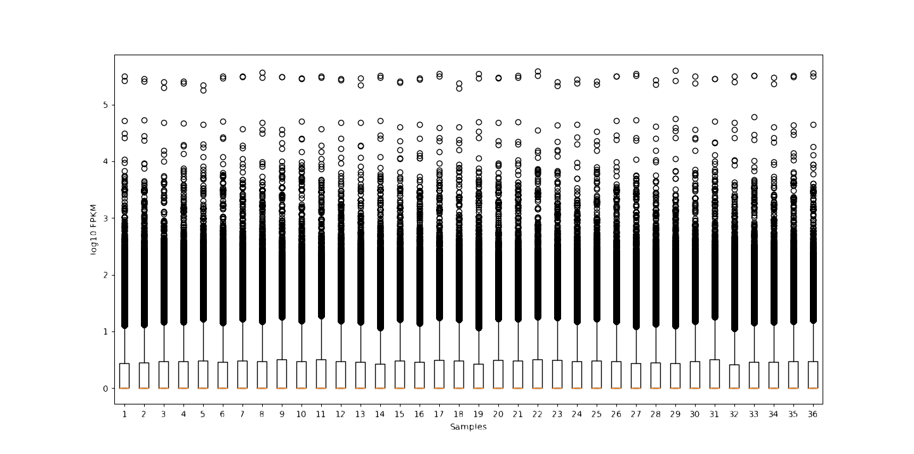
Figure 2. Gene Expression Distribution for Control Patients

Slide 9
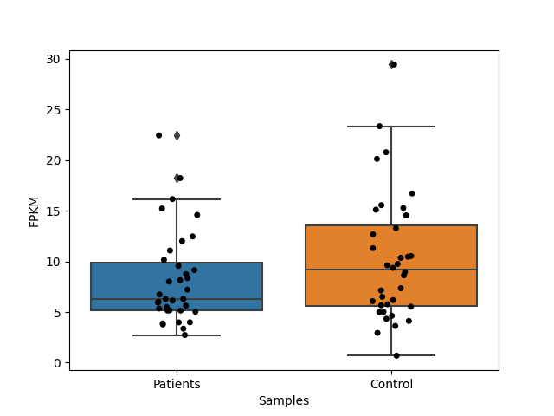
APOE Gene Expression Comparison

Slide 10
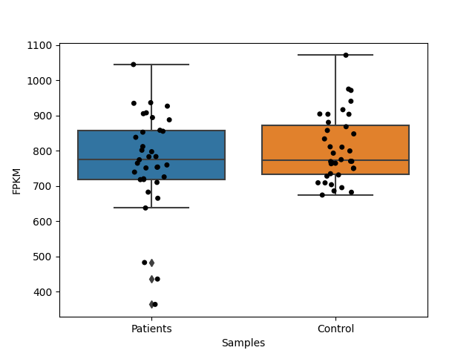
Beta-Actin Gene Expression Comparison

Slide 11
Results from T-test
Null Hypothesis: There is no difference in APOE Gene Expression
For the difference to be significant
p-value ≤ 0.05
P value = 0.139

Slide 12
Conclusion
Samples of Rush Alzheimer’s Disease Center showed no differences in APOE expression between AD patients and control

Slide 13
Future Directions
Looking at more Alzheimer’s Patient Data to increase sample size
Distinguishing the differences in genotypes between AD patients and Control patients

Slide 14
Citations
Bennett DA, Schneider JA, Buchman AS, Barnes LL, Boyle PA, Wilson RS. Overview and findings from the rush Memory and Aging Project. Curr Alzheimer Res. 2012 Jul;9(6):646-63. doi: 10.2174/156720512801322663. PMID: 22471867; PMCID: PMC3439198.
Bryant, Erin. “Study Reveals How APOE4 Gene May Increase Risk for Dementia.” National Institutes of Health, NIH’s National Institute on Aging (NIA), National Institute of Diabetes and Digestive and Kidney Diseases (NIDDK), National Cancer Institute (NCI), and National Institute of Neurological Disorders and Stroke (NINDS); Howard Hughes Medical Institute; Neurodegeneration Consortium; Robert A. and Renee E. Belfer Foundation; Ludwig Family Foundation; Kara and Stephen Ross., 30 Mar. 2021, https://www.nih.gov/news-events/nih-research-matters/study-reveals-how-apoe4-gene-may-increase-risk-dementia.
CORBO, R. M., and R. SCACCHI. “Apolipoprotein E (APOE) Allele Distribution in the World. IsApoe*4a ‘Thrifty’ Allele?” Annals of Human Genetics, vol. 63, no. 4, 28 Feb. 2003, pp. 301–310., https://doi.org/10.1046/j.1469-1809.1999.6340301.x.

